Slide 1
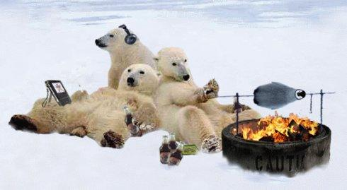
Polar Bears

Slide 2
标题和包含列表的内容布局
Cute right？
But they are endangered！

Slide 3
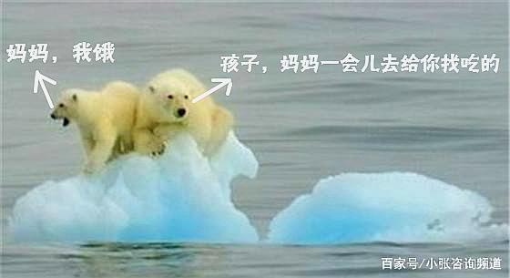
添加幻灯片标题 - 4
The recent unusually high temperatures have exacerbated the melting of sea ice in the arctic this summer, as global warming threatens tens of thousands of species. Most of them starve to death. Some media say the polar bear could be extinct in 40 years

Slide 4
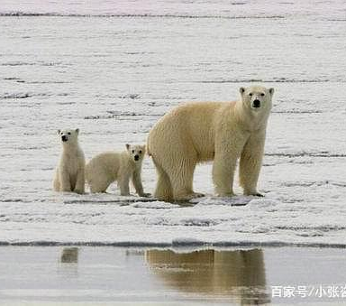
If the ice caps in the arctic continue to melt, polar bears may no longer be able to live in their dens, which could affect the survival of polar bears and their young. The tops and walls of the nests are not thick enough, and the nests may collapse, killing seals and reducing the bears' food supply. Polar bears have to travel great distances to find food. Since at least the beginning of this century, this distance has exceeded the range of polar bears' physical strength, and they end up drowning in the sea or starving to death in an ice-free environment.

Slide 5
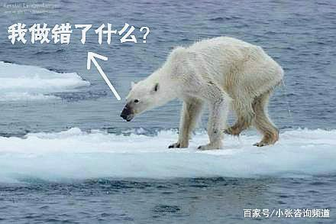
Polar bears now live in a very poor environment. Without ice, they can‘t hide and find food. The mother had to protect her baby from other bears, and now polar bears are killing each other. Polar bears are scrawny, no fat burning, living in the arctic with a temperature of more than 10 degrees below zero, not only starved to death, but also frozen to death, polar bears frozen to death? I thought it was a joke when I was little, but now I can't laugh.

Slide 6
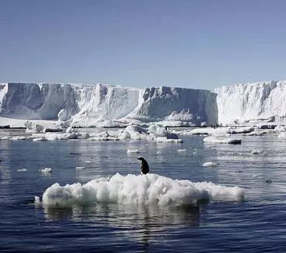
You may not believe it, but many polar bears that are good swimmers have drowned. The arctic, which used to be extremely cold, even reached 32 degrees Celsius this summer, and the ice began to melt in large areas. They are homeless, tired and hungry, the glaciers are fading fast, and they don't know where their homes are.

Slide 7
添加幻灯片标题 - 1
Thank you!

